Slide 1


P DILIP KUMAR

Slide 2


ZOMATO DATA EXPLORATION
Zomato is an Indian Multinational restaurant aggregator and food delivery company, founded by Deepinder Goyal and Pankaj Chaddah in 2008. Zomato provides information, menus and user-reviews of restaurants as well as food delivery options from partner restaurants in more than 1,000 Indian cities and towns, as of 2022-23.

Slide 3
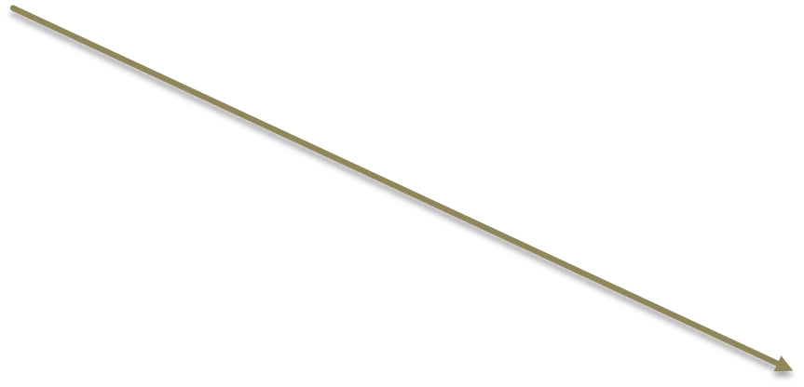
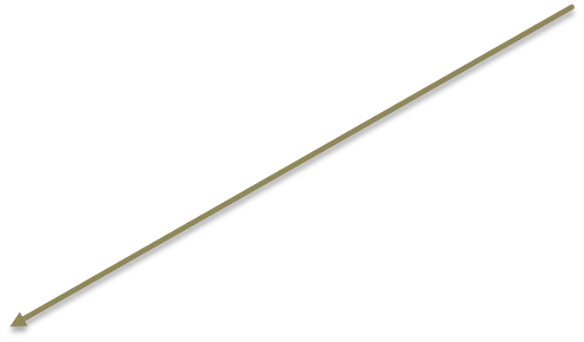
Entity Relationship Diagram
SALES
USERS
PRODUCT
GOLDUSERS_SIGNUP

Slide 4
Product
Sales
Users
Userid
Created_date
Product_id
Userid
Signup_date
Product_id
Product_name
Price
Goldusers_signup
Userid
Gold_signup_date

Slide 5
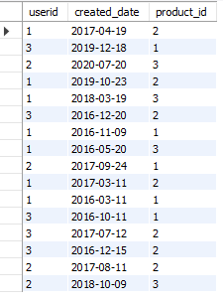

SALES TABLE
USERS TABLE

Slide 6



PRODUCT TABLE
GOLDUSERS_SIGNUP TABLE

Slide 7

What is the total amount each customer spent on Zomato ?
Select s.userid, sum(p.price) as Total_amount_spent from sales s right join product p on s.product_id=p.product_id group by userid order by userid;
OUTPUT

Slide 8

How many days visited each customer on Zomato ?
select userid, count(unique_dates)as Distinct_days from (Select distinct(created_date)as unique_dates, userid from sales) x group by userid order by userid;
OUTPUT

Slide 9

What was the first product purchased by each customer?
select * from(
select s.userid, p.product_name, s.created_date,
row_ number() over (partition by s.userid order by
s.created_date) as first_product from sales s
inner join product p on s.product_id=p.product_id)x
where first_product =1;
OUTPUT

Slide 10

what was the most purchased item on the menu and how many times was it purchased by all customer?
select userid, count(product_id) as count from sales where product_id = (
select product_id from sales group by
product_id order by count(product_id)
desc limit 1) group by userid;
OUTPUT

Slide 11

Which item was the most popular for each customer?
select * from (
select *,row_number() over(partition by userid
order by count desc) as row_no from (
select userid, product_id, count(product_id) as count
from sales group by userid,product_id) a ) b
where row_no=1;
OUTPUT

Slide 12

Which item was purchased first by the customer after they became a gold member?
Select * from (
Select *,row_number() over(partition by userid order by created_date)
as row_no from ( Select s.userid, s.product_id, s.created_date from
sales s inner join goldusers_signup g on s.userid=g.userid
where s.created__date>g.gold_signup_date) x) y where row_no=1;
OUTPUT

Slide 13

Which item was purchased just before the customer became a gold member?
select *from (
select *,row_number()over (partition by userid order by created_date desc) as
row_no from (select s.userid, s.product_id, s.created_date, g.gold_signup_date
from sales s inner join goldusers_signup g on s.userid=g.userid
where s.created_date<g.gold_signup_date) x) y where row_no=1;
OUTPUT

Slide 14

What is the total orders and amount spent for each member before they became a member?
Select s.userid, count(p.product_id) as order_purchased, sum(p.price) as Total_amount_spent from product p inner join sales s on p.product_id = s.product_id
inner join goldusers_signup g on s.userid = g.userid where s.created_date<g.gold_signup_date group by userid order by userid;
OUTPUT

Slide 15

If buying each product generates points for eg 5rs=2 zomato point and each product has different purchasing points for eg for p1 5rs=1 zomato point, for p2 10rs=5 zomato point and p3 5rs=1 zomato point. Calculate points collected by each customers and for which product most points have been given till now ?
1.Calculated points collected by each customer .
Select c.userid, sum(Total_points*2.5) as Total_earnings from (
Select b.userid,b.product_name,Total_amount, floor((Total_amount/points)) as Total_points from (
select a.*, ( case when product_name='p1' then 5
when product_name='p2’ then 2
when product_name='p3' then 5 else 0 end ) as points from (
Select s.userid, p.product_name, sum(p.price) as Total_amount from sales s inner join product p on s.product_id = p.product_id group by s.userid, p.product_name) a) b) c group by userid order by userid;
OUTPUT

Slide 16

2.which product most points given till now?
Select * from (
select c.*, row_number() over(order by Total_points desc) as row_no from (
select b.product_name, floor((Total_amount/points)) as Total_points from (
select a.*, ( case when product_name='p1' then 5
when product_name='p2’ then 2
when product_name='p3' then 5 else 0 end ) as points from (
Select p.product_name, sum(p.price) as Total_amount from sales s inner join product p on s.product_id = p.product_id group by p.product_name) a) b) c) d
where row_no=1;
OUTPUT

Slide 17

In the first one year after a customer joins the fold program(including their join date)irrespective of what the customer has purchased they earn 5 zomato points for every 10rs spent who earned more and whar was their points earnings in their first year?
select c.userid, c.created_date, c.product_id, c.gold_signup_date, Total_points,
row_number() over ( order by Total_points desc as row_no from (
Select b.*, floor ((Total_amount/points)) as Total_points from (
select a.*,( case when product_id then 2 else 0 end) as points from (
select s.userid,s.created_date,g.gold_signup_date,s.product_id,sum(p.price) as Total_amount
from product p inner join sales s on p.product_id = s.product_id inner join goldusers_signup g
on s.userid = g.userid where created_date>=gold_signup_date and created_date<=date
Add (gold_signup_date, interval 1 year)
group by userid, created_date, gold_signup_date, product_id) a) b) c ;
OUTPUT

Slide 18
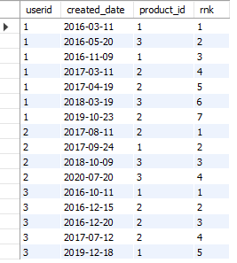
Rank all the transaction of the customers?
Select *,rank() over(partition by userid order by created_date) as rnk from sales;
OUTPUT

Slide 19
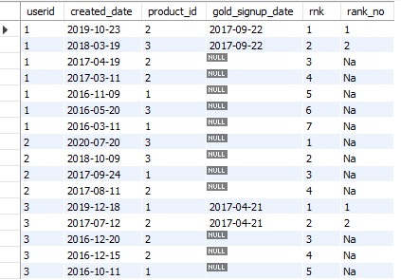
Rank all the transactions for each member whenever they are a Zomato gold member -- for every non gold member transactions mark as “Na” ?
Select b.*, (case when gold_signup_date then rnk
when gold_signup_date is NULL then ‘Na' end) as rank_no from (
select a.*,rank() over(partition by userid order by created_date desc)
as rnk from (
Select s.userid, s.created_date, s.product_id, g.gold_signup_date
from sales s left join goldusers_signup g on s.userid = g.userid and
s.created_date >= g.gold_signup_date) a) b;
OUTPUT

Slide 20


